Slide 1
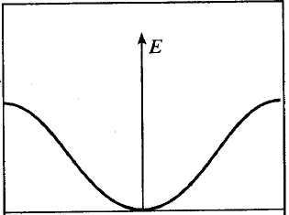
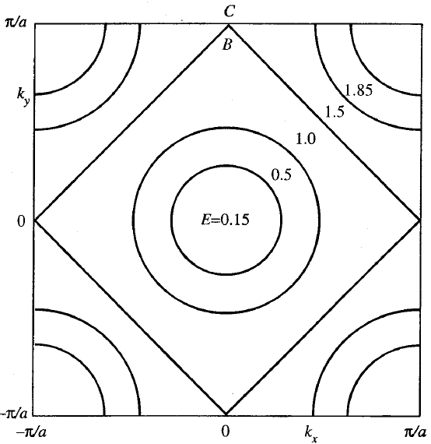
Band Filling in 2-D
electrons
E=1.0, 1.5
@ k_{y}=π/a
1.5
C
D
k_{xy}
1.0
B
k_{y}
k_{y}
2.0
D
holes
k_{xy}

Slide 2
Band Filling in 2-D
electrons
E=1.0, 1.5
@ k_{y}=π/a
1.5
C
D
k_{xy}
1.0
B
k_{y}
k_{y}
2.0
D
holes
k_{xy}

Slide 3
Band Filling in 2-D
electrons
E=1.0, 1.5
@ k_{y}=π/a
1.5
C
D
k_{xy}
1.0
B
k_{y}
k_{y}
2.0
D
holes
k_{xy}

Slide 4
Band Filling in 2-D
electrons
E=1.0, 1.5
@ k_{y}=π/a
1.5
C
D
k_{xy}
1.0
B
k_{y}
k_{y}
2.0
D
holes
k_{xy}

Slide 5
E
Conduction
Band
E
Conduction
Band
T=0
T >>0
Energy
Gap
Energy
Gap
E_{f}
Valence
Band
Valence
Band
f(E)
f(E)
Filled States
Empty States

